Slide 1

Design Masterclass Group 1
Design Masterclass.
Ubisoft.
Samuel Cook: Game Design & Art.
William Terry: Programming.

Slide 2
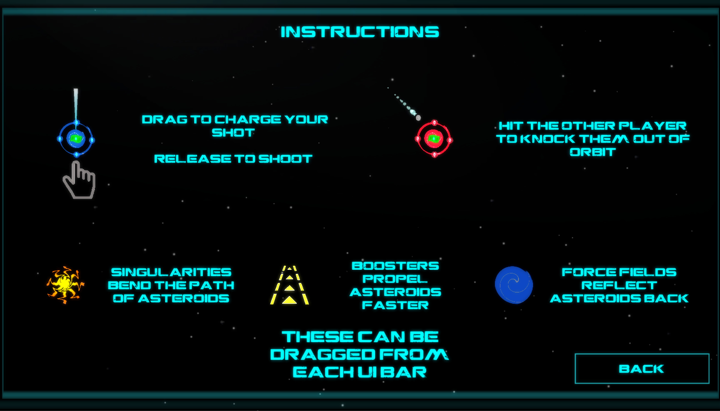
Player Instructions.

Slide 3
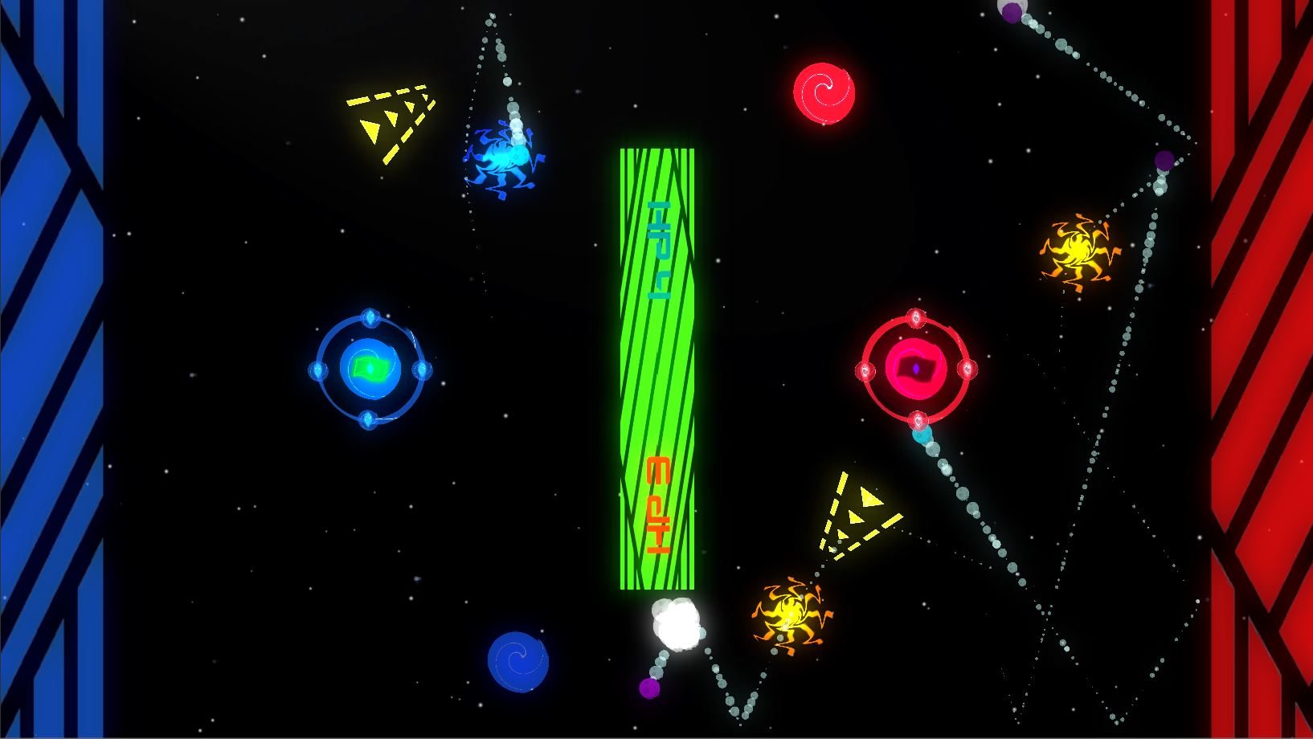


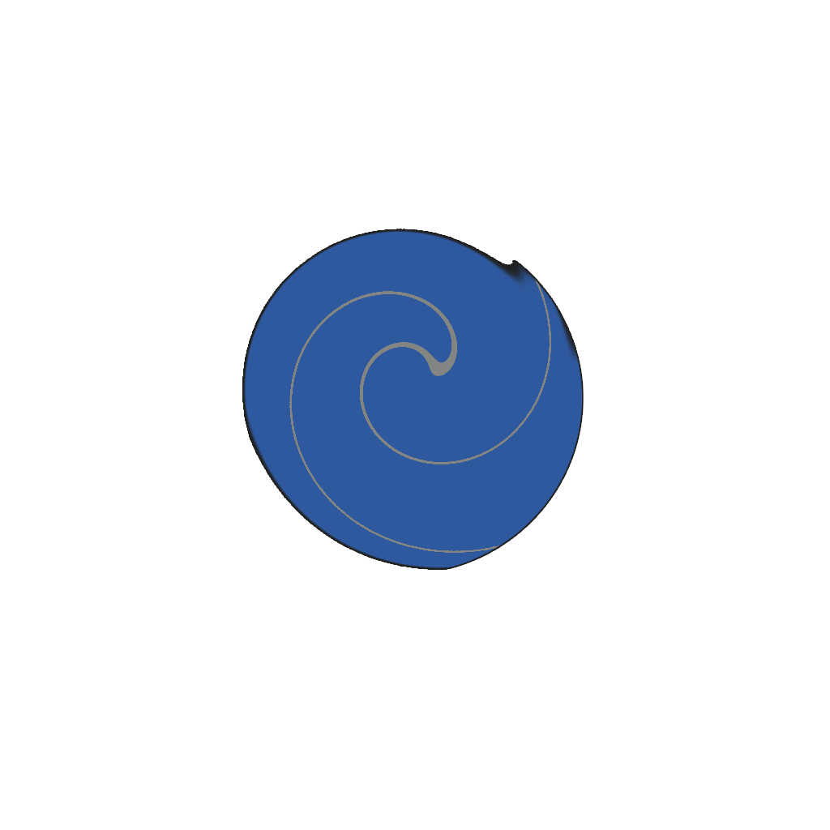
Player Actions.

Slide 4

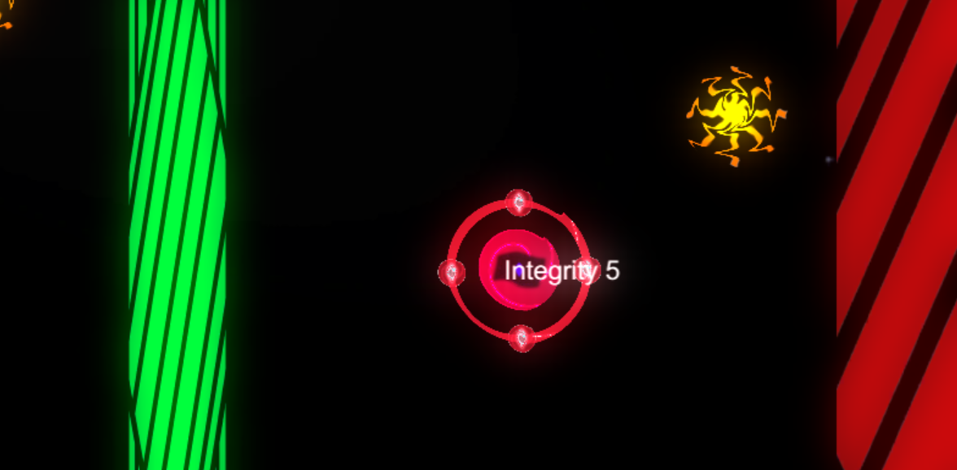
Purchasable Items
Items can be bought with points earned by hitting the other player’s base
Player will drag them from their shop to the play area

Slide 5
Component Breakdown
Boosters can be placed in the game to speed up projectiles that fly through them.
Forcefields can be placed to block enemy projectiles reflecting them back the direction they came.
Singularities can be placed to block enemy asteroids and cause them to spin away randomly.

Slide 6
Design Deviations
Initially we had had the projectiles as a purchasable from the UI bar however this proved to be too many actions for the player to take at once as they also had to move the player at the same time
We made the player static and made the asteroids always shoot from the players location.

Slide 7
Steps to take
Finish Purchasing mechanic
Polish Shooting (Touch input handling)
Iterate on art style
Player feedback on GUI design (Player HP)
Purchased items should break after a number of uses
Projectiles should die after a number of bounces
Matching projectile trail colours

Slide 8
Questions?

